Slide 1

Computer Vision

Slide 2

What is Computer Vision?
Computer vision is a branch of science that is concerned with processing images to extract, analyze, and understand useful information from a single image or image sequence.
The main purpose of using computer vision technology in ML and AI is to create a model that can work itself without human intervention, it aims at simulating the human visual system.
It uses various machine learning and deep learning algorithms to analyze images for scenes, objects, faces, and other content in videos, photos, and pictures in general.

Slide 3
Computer vision History

Slide 4
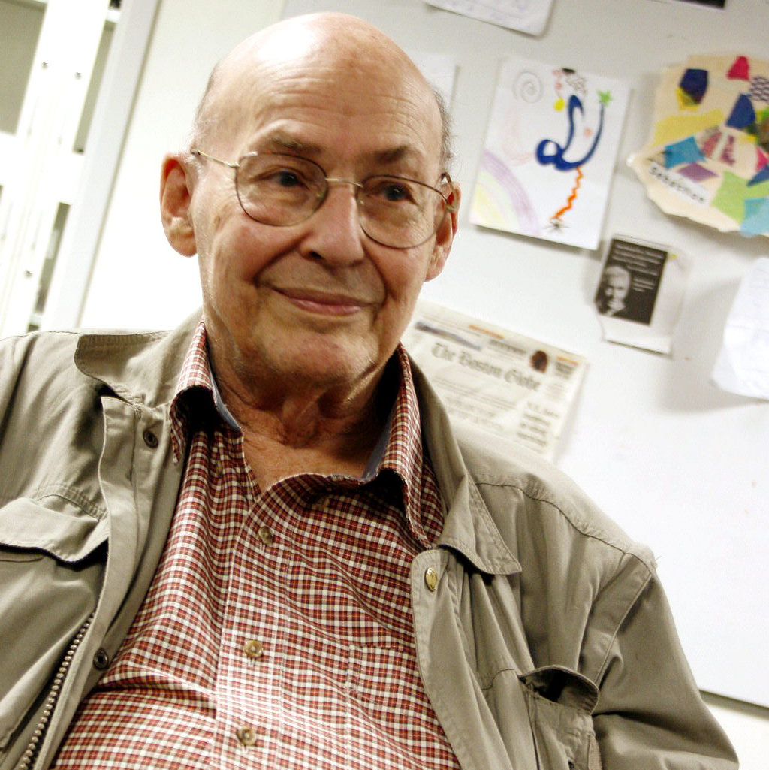
In the late 1960s, computer vision began at universities which were pioneering artificial intelligence. It was meant to mimic the human visual system.
In 1966, American computer scientist and co-founder of the MIT AI Lab Marvin Minsky made the first attempt to mimic the human brain through a summer project, by attaching a camera to a computer and having it “describe what it saw”.
Marvin Minsky
Co-founder of MIT AI Lab
Convolutional neural networks were proposed in the well-known 1998 research paper by Yann LeCun and Léon Bottou.

Slide 5
In 2012, Google Brain built a neural network of 16,000 computer processors which could recognize pictures of cats using a deep learning algorithm.
In less than a decade, today's systems have reached 99 percent accuracy from 50 percent making them more accurate than humans at quickly reacting to visual inputs.

Slide 6
Computer Vision & Image Processing

Slide 7
Difference between image processing and computer vision:
Image processing is the process of creating a new image from an existing image, typically simplifying or enhancing the content in some way.
It is a type of digital signal processing and is not concerned with understanding the content of an image.
Computer vision helps to gain a high-level of understanding from images or videos.
A given computer vision system may require image processing to be applied to raw input.

Slide 8

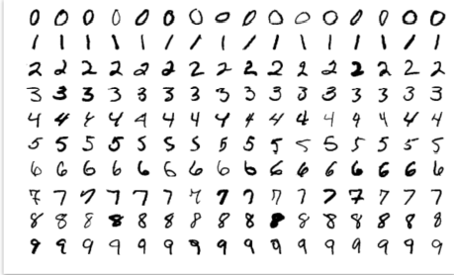
Image processing

Slide 9
Computer Vision Applications

Slide 10
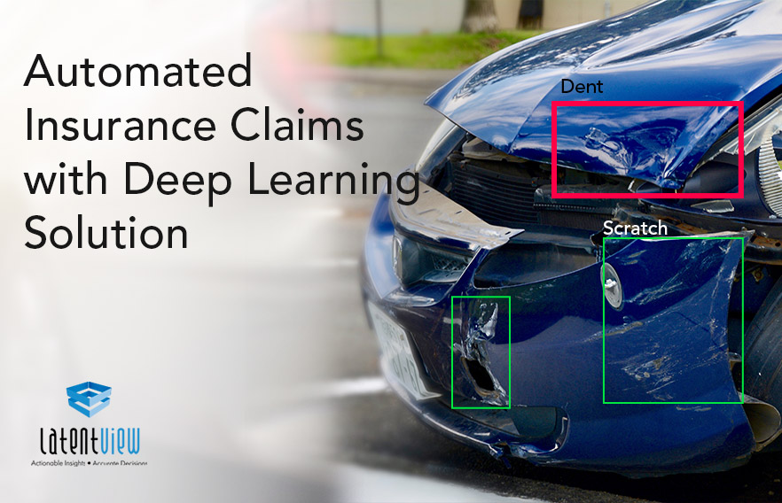
• Insurance: Classify claims images into different categories.

Slide 11
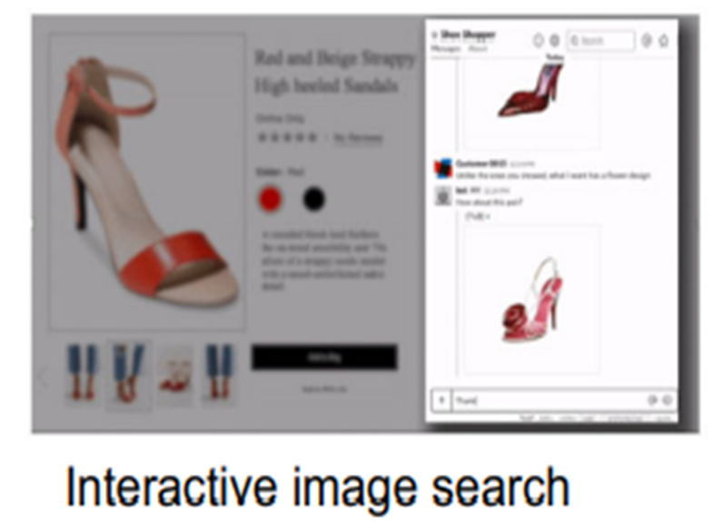
• Social commerce: Use an image of a product to find similar products for sale.

Slide 12

• Automotive industry: Object detection for safety.

Slide 13
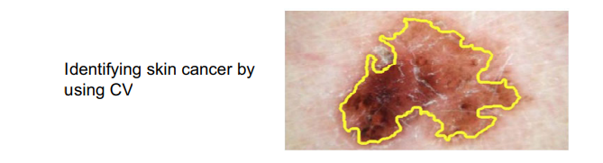
• Medical image processing: Detect tumors.

Slide 14
Computer Vision Tools

Slide 15
Scikit-image: is a collection of algorithms for image processing.
OpenCV: offers all kinds of algorithms from basic image processing to advanced computer vision.
PyTorchCV: is an open source machine learning library used primarily for applications such as computer vision and natural language processing.

Slide 16
Computer Vision Use Cases

Slide 17
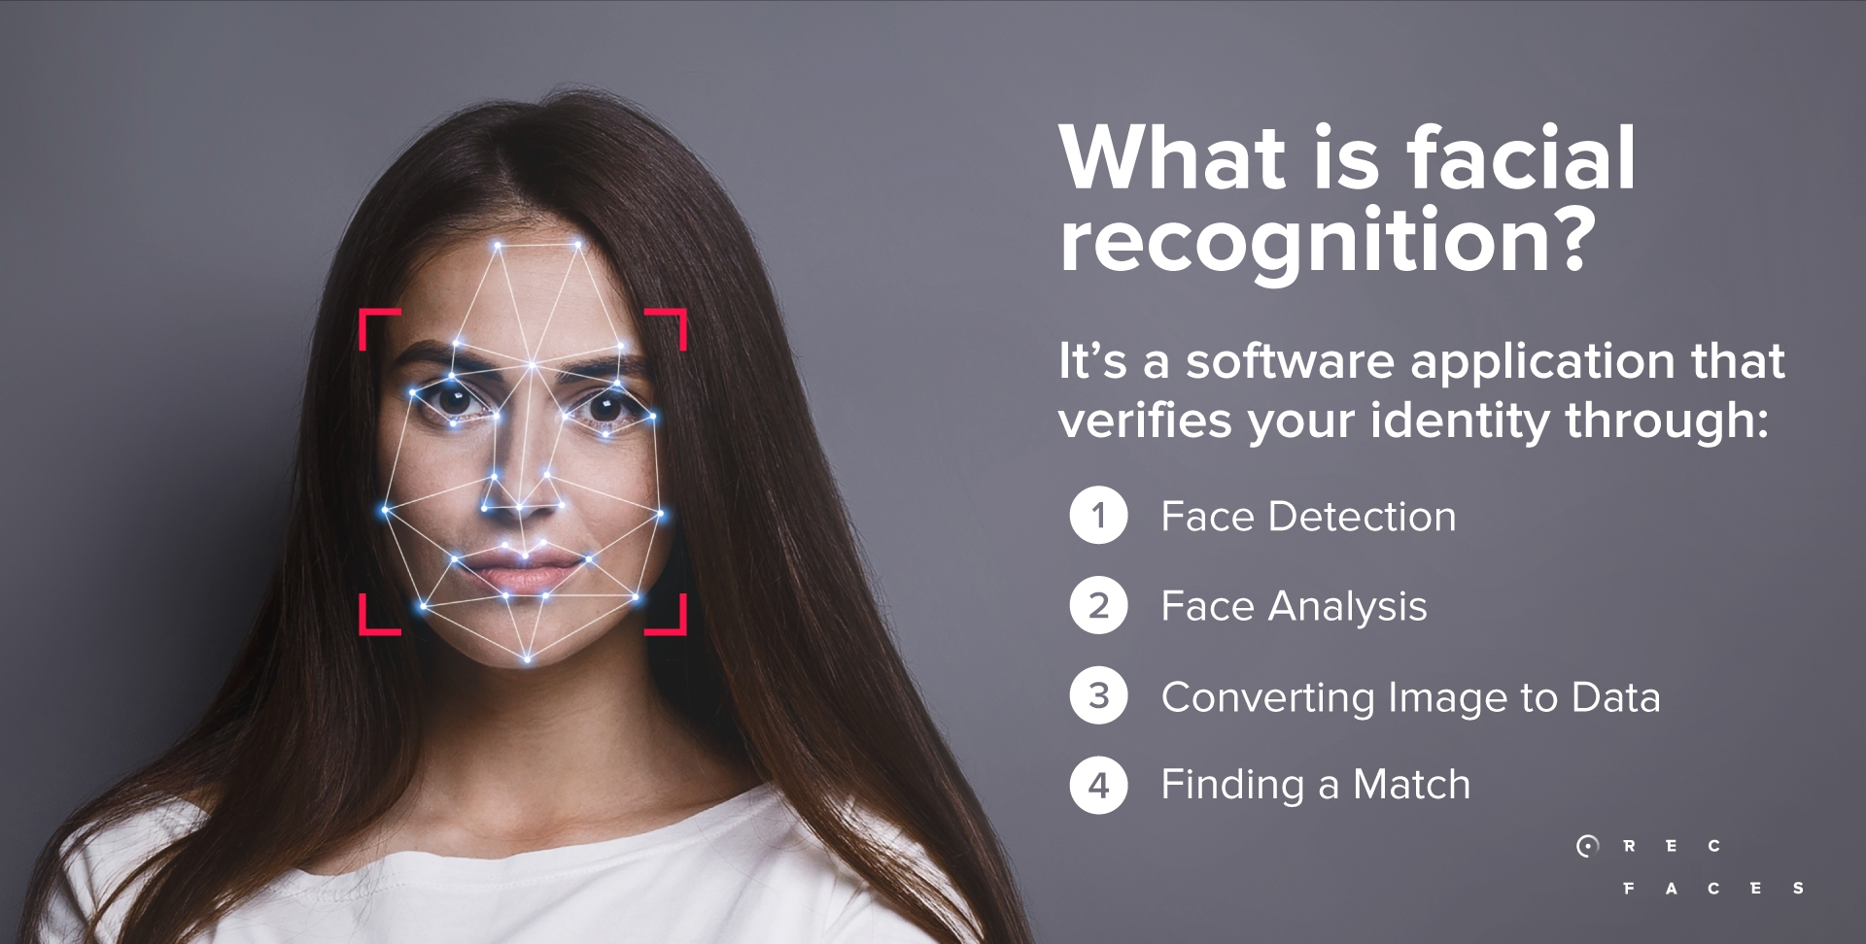
Facial recognition:
We use facial recognition daily.
Taking a photo and applying effects by using your smartphone.
Tagging friends on social media.

Slide 18
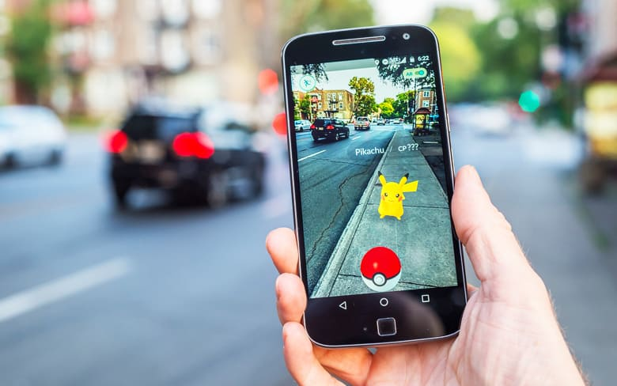
Augmented reality:
Manipulation and addition of a system-generated image (3D or 2D) as an overlay of a user’s view.
Examples: Google Glass, emoji filters in some mobile apps, and Pokémon Go.
Mobile shopping applications will give in-store shoppers instant product details and promotions through their mobile devices.

Slide 19
Image Representation

Slide 20
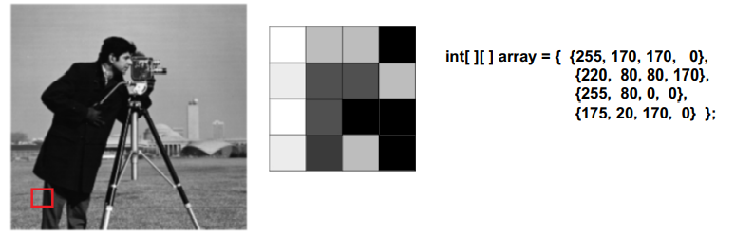
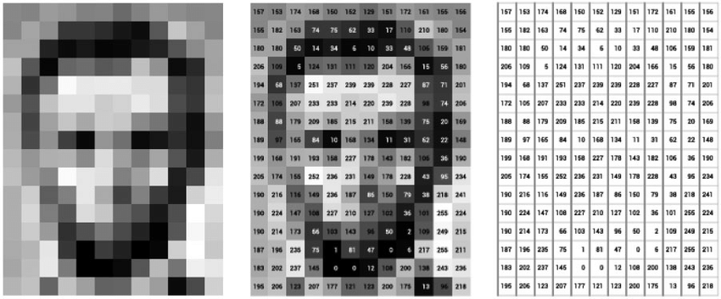
Images are stored as a 2D array of pixels on computers.
Each pixel has a certain value representing its intensity.
Example of grayscale representation:
Image is black and white with shades of gray in between.
Pixel intensity is a number between 0 (black) and 255(white).

Slide 21
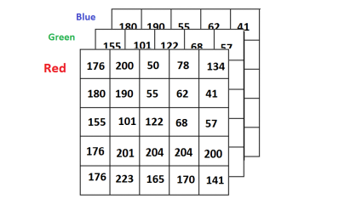
Example of color representation:
The pixel color is represented as a mix of Red, Green, and Blue.
The pixel intensity becomes three 2D arrays or one 2D array, where each entry is an object containing the 3 color values of RGB.

Slide 22
Computer Vision Pipeline

Slide 23
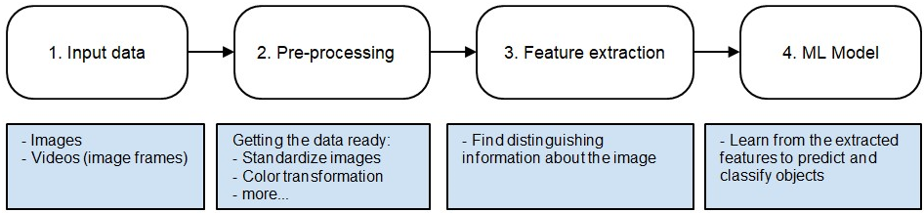
What is computer vision pipeline?
It is a sequence of distinct steps to process and analyze image data. Here is a conventional visual pattern recognition pipeline:

Slide 24
How images flow through computer vision pipeline:
A computer receives visual input from an imaging device like a camera.
Each image is sent through some pre-processing steps whose purpose is to standardize each image.
Then we extract features. Features are what help us define certain objects, and they’re usually information about object shape or color.
Finally, these features are fed into a ML model(e.g. classification model), this step looks at the features vector from the previous step and predicts the class of the image.

